Slide 1
Automobile Dashboard Analysis
Analysis of automobile sales across vehicle types, regions, and time
Dataset includes sales price, cost price, vehicle type, country, and invoice date
Built using Power BI with DAX, Power Query, and interactive visuals
Objective: understand sales trends, profitability, and performance against targets

Slide 2
Business Objective
Track total sales and profit over time
Compare performance across vehicle categories and regions
Analyze the relationship between sales and profit
Measure performance against sales targets
Provide an interactive dashboard for decision making

Slide 3
Dataset Overview
Time: Invoice Date (Year, Month)
Product: Vehicle Type, Make, Model
Geography: Country
Financials: Sale Price, Cost Price, Discounts
Derived Metrics: Profit, Profit Margin %, Sales Variance, Targets

Slide 4
Methodology
Cleaned and transformed data using Power Query
Removed unnecessary columns and duplicates
Created calculated columns like Total Cost
Built DAX measures for:
Total Sales
Profit
Profit Margin %
Sales Target
Sales Variance
Designed visuals aligned to each analytical question

Slide 5
Analytical Approach
Descriptive analysis: Total sales, profit, category performance
Comparative analysis: Vehicle type and region comparisons
Trend analysis: Monthly and yearly sales trends
Relationship analysis: Sales vs profit
Performance tracking: KPI, gauge, and variance visuals
Storytelling: Slicers and bookmarks for guided navigation

Slide 6
KPI Snapshot (Cards & KPI Visual)
Dashboard Elements:
Card: Total Sales
Card: Profit
Card: Profit Margin %
KPI Visual:
Indicator: Total Sales
Target: Sales Target
Trend Axis: Invoice Date
What it shows:
Quick summary of overall business performance
Clear comparison of actual sales vs target
Sales trend over time

Slide 7
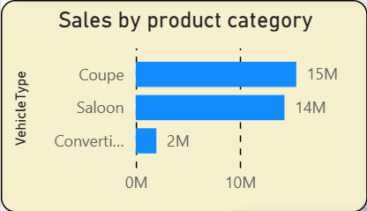
Sales by Vehicle Type (Bar Chart)
Visual Used: Bar Chart Fields:
Axis: Vehicle Type
Values: Total Sales
Key Observation:
Sales contribution varies significantly by vehicle category
Certain vehicle types dominate overall revenue

Slide 8
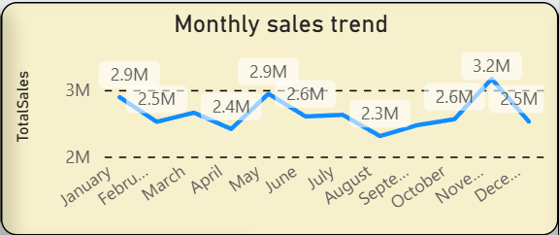
Monthly Sales Trend (Line Chart)
Visual Used: Line Chart Fields:
X-Axis: Invoice Date (Month)
Y-Axis: Total Sales
Key Observation:
Sales fluctuate across months
Clear periods of growth and slowdown visible
Useful for identifying seasonality

Slide 9
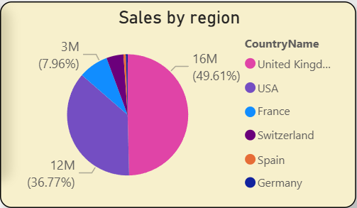
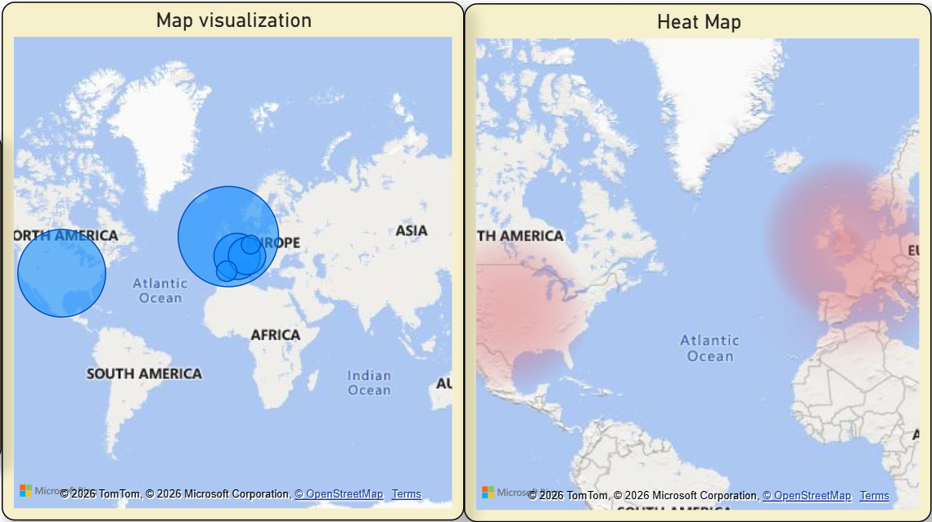
Regional Sales Distribution (Pie / Map)
Visuals Used:
Pie Chart: Sales by Country
Map Visual: Geographic sales distribution
Key Observation:
Some regions consistently outperform others
High-sales countries stand out clearly on the map

Slide 10
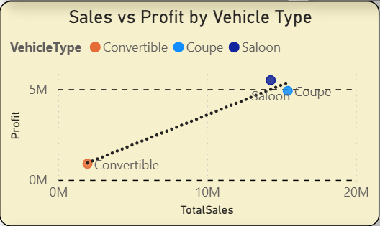
Sales vs Profit Relationship (Scatter Plot)
Visual Used: Scatter Plot Fields:
X-Axis: Total Sales
Y-Axis: Profit
Legend: Vehicle Type
Key Insight:
Higher sales do not always result in higher profit
Profitability varies across vehicle categories

Slide 11
Profitability Analysis
Metrics Used:
Profit
Profit Margin %
Insight:
Some vehicle types show strong sales but lower margins
Cost control plays a major role in profitability

Slide 12
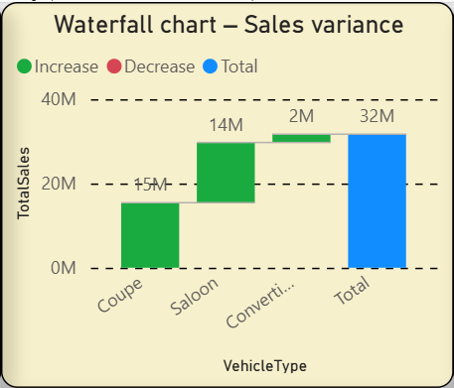
Sales Variance Analysis (Waterfall Chart)
Visual Used: Waterfall Chart Fields:
Category: Vehicle Type / Time
Values: Sales Variance (Actual – Target)
Key Insight:
Shows positive and negative contributions clearly
Helps explain how different segments impact total variance

Slide 13
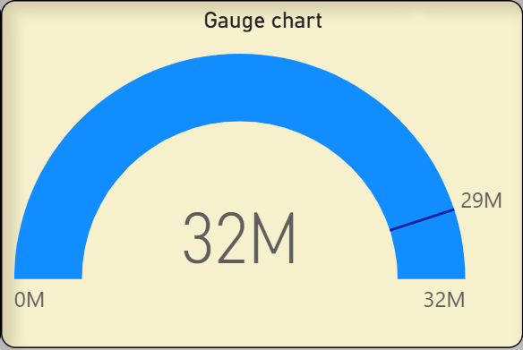
Performance vs Target (Gauge Chart)
Visual Used: Gauge Chart Fields:
Value: Total Sales
Target: Sales Target
Minimum: 0
Key Insight:
Immediate visual indication of target achievement
Easy for management to interpret performance status

Slide 14
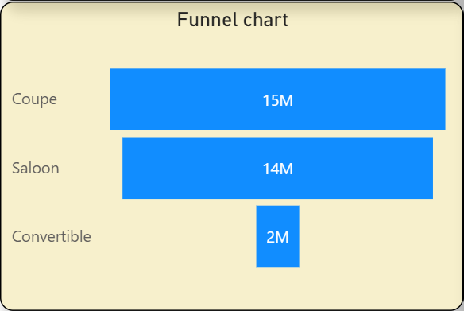
Sales Funnel (Funnel Chart)
Visual Used: Funnel Chart Fields:
Group: Vehicle Type
Values: Total Sales
Key Insight:
Highlights drop-off in sales contribution across categories
Identifies top and bottom contributors

Slide 15
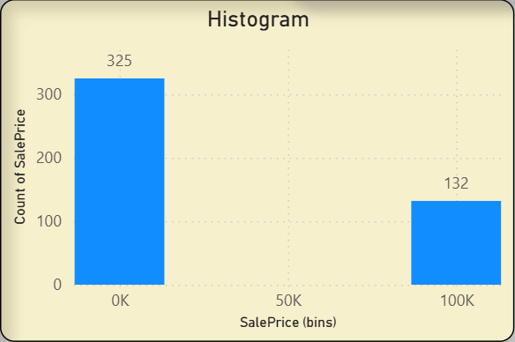
Distribution of Sales Amounts (Histogram)
Visual Used: Clustered Column Chart (Histogram) Fields:
X-Axis: Sale Price (Bins)
Y-Axis: Count of Sales
Key Insight:
Shows how sales values are distributed
Helps identify common price ranges and outliers

Slide 16
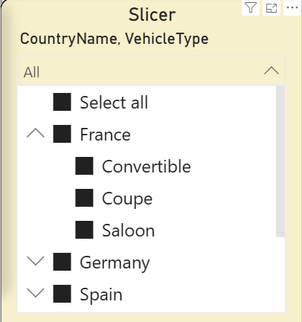
Interactive Filtering (Slicers)
Slicers Used:
Vehicle Type
Country
Benefit:
Allows users to dynamically filter the dashboard
Improves exploration and usability

Slide 17
Key Findings
Vehicle category performance is uneven
Certain regions drive the majority of sales
Sales growth does not always align with profit growth
Targets help highlight performance gaps clearly

Slide 18
Actionable Recommendations
Focus marketing and inventory on high-profit vehicle types
Review costs for high-sales, low-margin categories
Set realistic sales targets based on historical trends
Use KPIs and alerts for continuous performance tracking

Slide 19
Conclusion
Power BI effectively transformed raw sales data into insights
DAX and Power Query enabled accurate and flexible analysis
Visuals clearly communicated trends, comparisons, and performance
The dashboard supports informed, data-driven decision making

